Slide 1


Investigation of Vulnerabilities in Open RAN Implementations
Research Project – WS 22/23
Arnova Abdullah
Weekly meeting-10 (21.12.2022)

Slide 2
Previous Weeks Meeting Details
Week 1 Meeting (19.10.2022)
Basics about Radio Access Network (History, parts of RAN for 1G, 2G, 3G, 4G)
Basics about Open RAN (Distribution unit, central unit, user plane, control plane, interfaces, front haul, mid haul, backhaul)
Open RAN risk analysis (Stakeholders of attackers-User, external attacker, cloud operator**, RAN operator**)
Week 2 Meeting (26.10.2022)
Installation of Kali Linux and Metasploitable
Atomic Red Team GitHub repository download
Research other open-source attack tools
Week 3 Meeting (02.11.2022)
Penetration testing using Kali Linux
Try Atomic tests by invoke-atomic
Get used to commands used for running a test
Research details about one of the attack tools - Infection Monkey
Read research papers on the risk of 5G open RAN
Week 4 Meeting (09.11.2022)
Finding the most relatable attacks from the MITRE ATTACK list (On going)
CyberOps course ongoing
Research paper by MOU

Slide 3

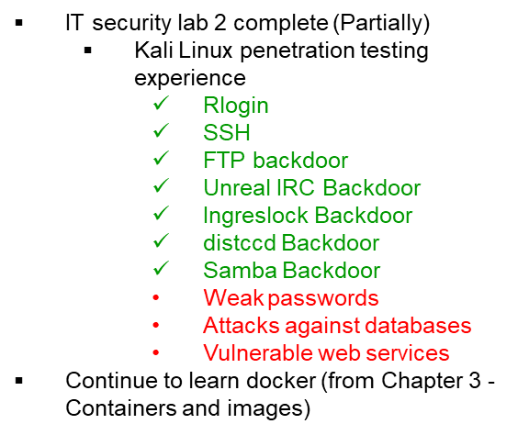

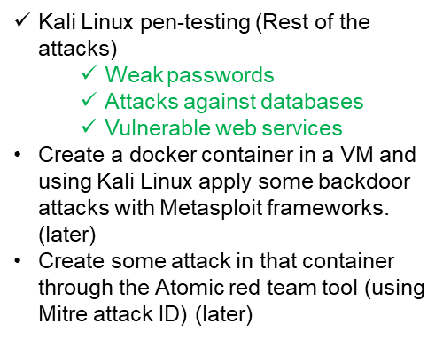
Previous Weeks Meeting Details
Week 5 Meeting (17.11.2022)
Install Infection monkey (Need AWS subscription, don’t continue anymore!!)
Start learning Docker container
https://developer.cisco.com/learning/tracks/containers/
https://learning.oreilly.com/videos/docker-fundamentals-for/9781803237428/9781803237428-video1_1/
Week 8 Meeting (08.12.2022)
Make a comparison between Kali Linux tools and Atomic Red Team
Select one to use at the end of the project
Week 9 Meeting (15.12.2022)
No update

Slide 4
Week 10 (Until 21.12.2022)
Research:
Is there a map between MITRE ID to CVE list?
In Kali Linux, is there any tool or settings to map CVE or MITRE ID?
Create an extended comparison between Atomic and Kali in MS Excel (Will prepare it by January)
Create a list for Docker, and Kubernetes attacks:
How to attack the docker container? Which version?
What are the tools? (If required any)
What are the known vulnerabilities? (CVE, MITRE)
Create a list for Ubuntu:
Which Ubuntu version?
How to attack Ubuntu?
What are the tools? (If required any)
What are the known vulnerabilities? (CVE, MITRE)

Slide 5
Research
Is there a map between MITRE ID and to CVE list?
Founded in 1999, the CVE program is maintained by the MITRE Corporation and sponsored by the U.S. Department of Homeland Security (DHS) and the Cybersecurity and Infrastructure Security Agency (CISA).
Yes, the mapping between MITRE and CVE can be done.
There is an additional Github project from https://ctid.mitre-engenuity.org/our-work/attck-to-cve/ for the mapping between MITRE and CVE.
Github project link: https://github.com/center-for-threat-informed-defense/attack_to_cve
Other projects working on mapping: (This pdf provides a good overview that all CVE can not be mapped to all MITRE ATT&CK)
https://info.cyr3con.ai/hubfs/Mapping%20CVE%20Records%20to%20the%20ATT%26CK%20Framework.pdf
In Kali Linux, is there any tool or settings to map CVE or MITRE ID?
Vulmap to map CVE ID (need to research more)
https://github.com/vulmon/Vulmap

Slide 6
Attack List
Create a list of the underlying components vulnerabilities from CVE:
https://www.cvedetails.com/ provides an easy to use web interface to CVE vulnerability data.
We can browse for vendors, products and versions and view CVE entries, vulnerabilities, related to them.
We can also view statistics about vendors, products and versions of products.
Create a list of Kubernetes known vulnerabilities from CVE:
https://www.cvedetails.com/vulnerability-list/vendor_id-15867/product_id-34016/Kubernetes-Kubernetes.html
Create a list of Ubuntu 20.04 known vulnerabilities from CVE:
https://www.cvedetails.com/vulnerability-list/vendor_id-4781/product_id-20550/version_id-579251/opbyp-1/Canonical-Ubuntu-Linux-20.04.html
Create a list of Docker known vulnerabilities from CVE:
https://www.cvedetails.com/vulnerability-list/vendor_id-13534/product_id-28125/Docker-Docker.html

Slide 7
Important links to search details about Kali tools (self study)
https://resources.infosecinstitute.com/topic/top-18-tools-for-vulnerability-exploitation-in-kali-linux/
https://resources.infosecinstitute.com/topic/vulnerability-mapping-with-kali-linux/
https://www.systranbox.com/how-to-search-cve-kali-linux/

Slide 8
Next Steps (Week 11) Until 11.01.2023
Research more about Vulmap.
Which type of attack can it do?
Install it in Kali Linux and have practical experience with it.
Do the lab of Docker from Devnet.
If it is installed, then try some attacks with kali and atomic by mapping to CVE/MITRE. Use the list from previous page list.
Have some more practical experience with Atomic red team.

